Slide 1

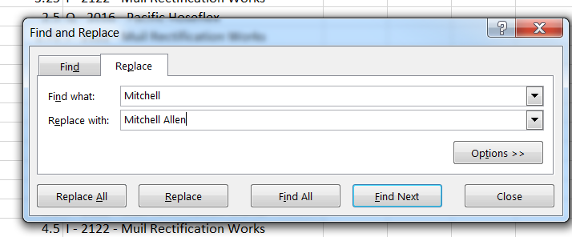
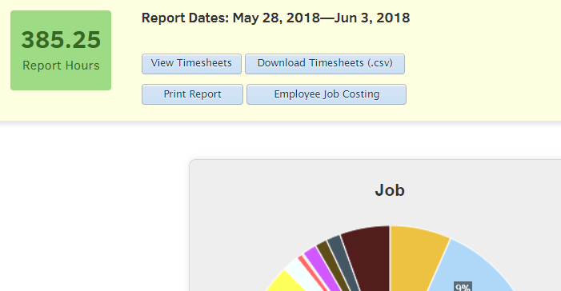
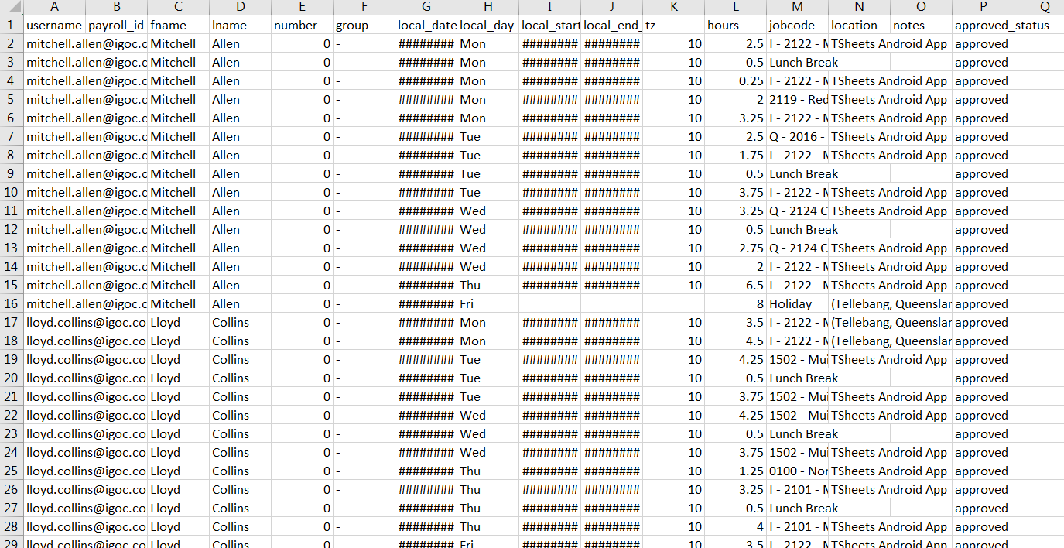
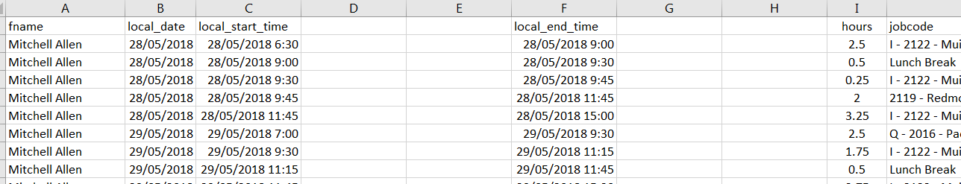
Billable Hours Weekly Report
OPEN up Tsheets
Go to Reports and click on Project reports
Select report dates by week
Click run report
Click on Download timesheets (.csv)
Remove columns A, B, D, E, F, H, K, N, O, P
Select ‘ctrl f’, select the replace tab & replace names with the full name, eg. Mitchell to Mitchell Allen, click replace all.
Continue this step with all employees
The below will automatically open in excel
Now time to EDIT spreadsheet ☺
Insert two columns to the left of column ‘D’
Then insert two columns to the right of column ‘G’
Your spreadsheet should look a bit like this….

Slide 2
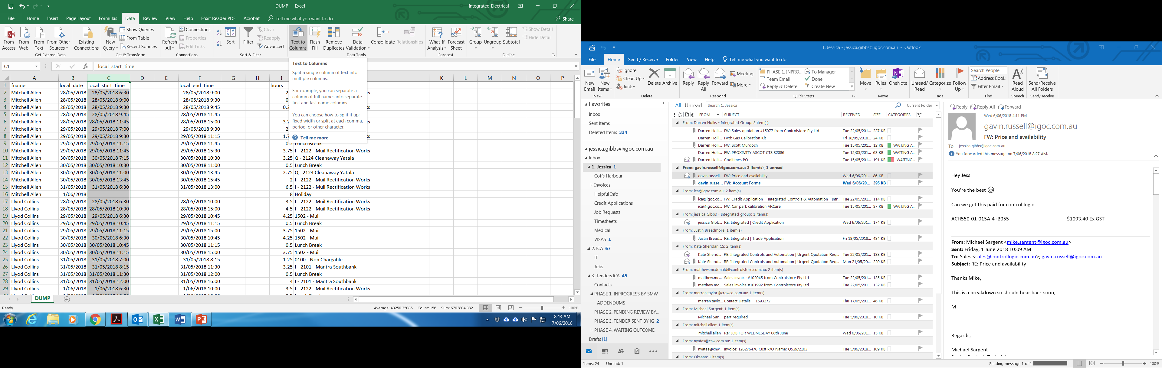
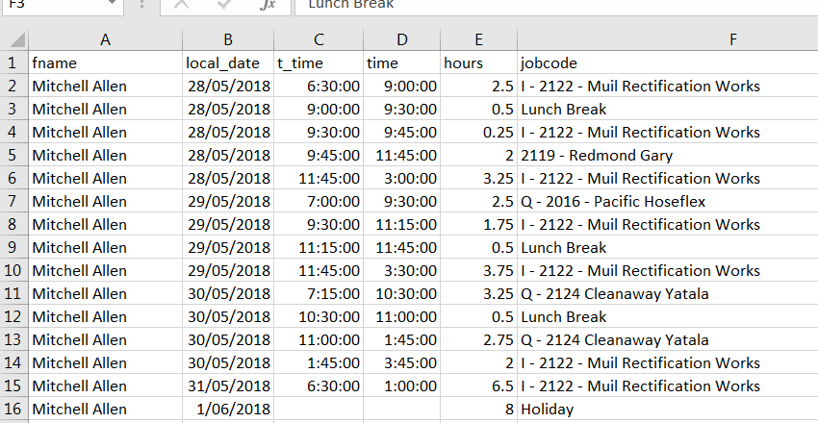
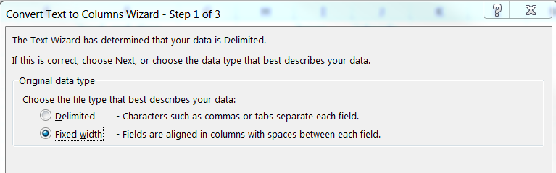
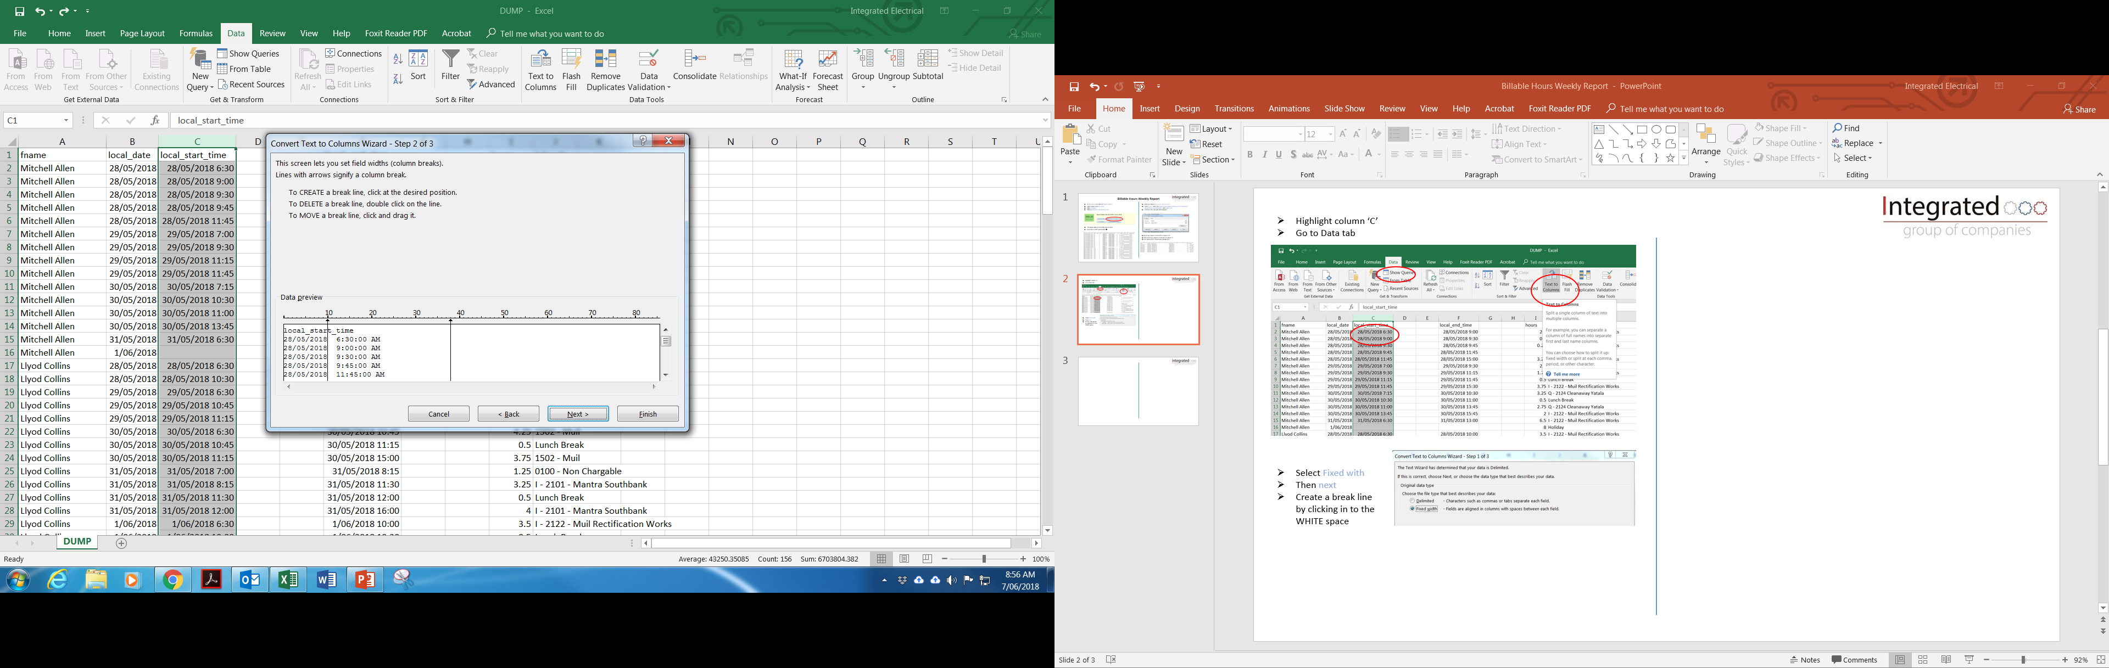
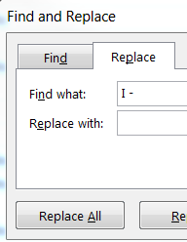
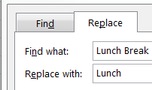
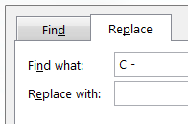
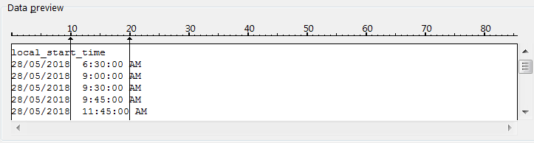
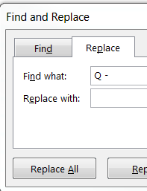
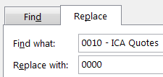
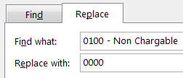
Highlight column ‘C’
Go to Data tab & click on ‘Text to columns’
Once you have followed the above steps your spreadsheet should now look like this…
Select Fixed width
Then next
Create a break line by clicking anywhere in the WHITE space
Move the arrows to indicate where you want the break to be placed
Then click next & finish
Your data will now be imported in to previously blank columns
Delete unnecessary columns eg. ‘C’ & ‘E’
Repeat the above steps for column ‘F’
Now to tidy up column ‘F’
Press ctrl F, go to replace tab
Type “I -” in find what and keep replace with blank, click on replace all and repeat for Q -, Lunch Break, C - , PLUS 0010 – ICA Quotes & 0100 – Non Chargeable are ALL to be replaced with “0000” - Examples below:

Slide 3
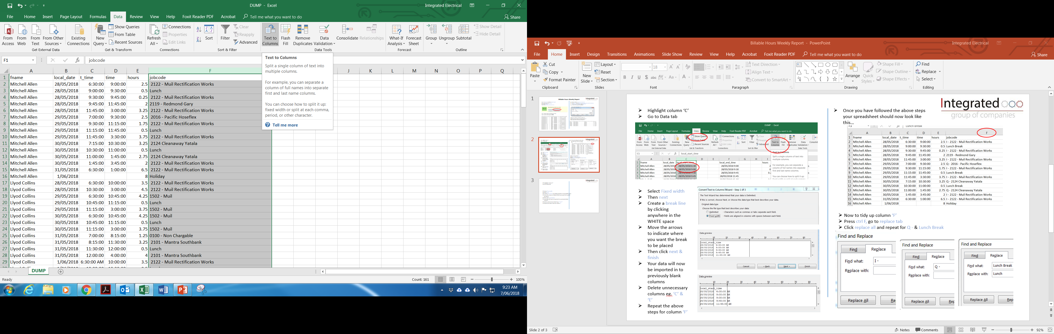
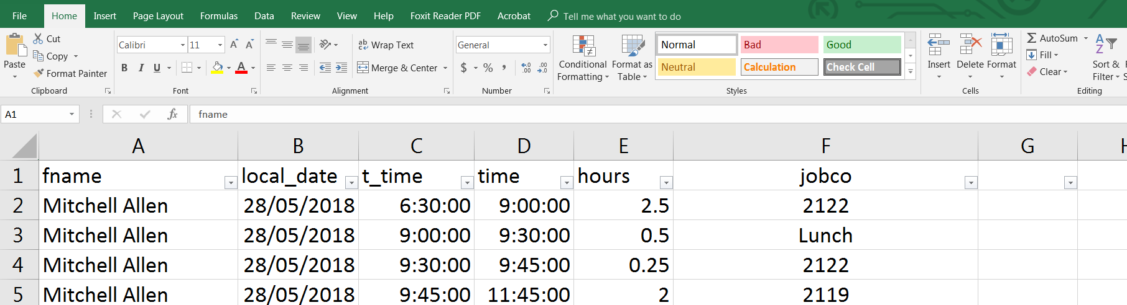
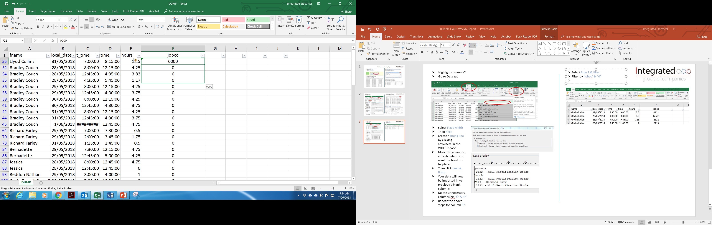
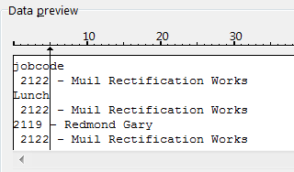
Highlight column ‘F’
Go to Data tab & click on ‘Text to columns’
Select Row 1 & filter
Filter by ‘jobco’ & “0”
Change settings in cell F2 from ‘general’ to ‘TEXT’ as circled
Then edit cell F2 from “0” to “0000”
Go to the bottom right hand corner of cell and drag to the bottom, replacing ALL “0” to “0000”
Filter any other job numbers/holidays/sick leave that DO NOT look right
You may also need to update the time where applied against LEAVE as this will be blank ie. Key 07:00 to 15:00 = 8hrs
Select Fixed width
Then next
Move the arrows to indicate where you want the break to be placed
If you need a NEW break line, click in the WHITE space
Once you are happy with positioning, then click next & finish
Your data will now be imported in to previously blank columns
Delete unnecessary columns
Codes:
A/L = Annual Leave
B/L = Bereavement Leave
P/L = Parental Leave
LWOP = Leave without pay
P/HOL = Public Holiday
S/L = Sick Leave
NB: Holidays, Sick leave etc – you will need to determine what type. PLEASE USE these codes
Once this is complete, clear filters AND you are NOW ready to import in to Billable Hours Spreadsheet.

Slide 4
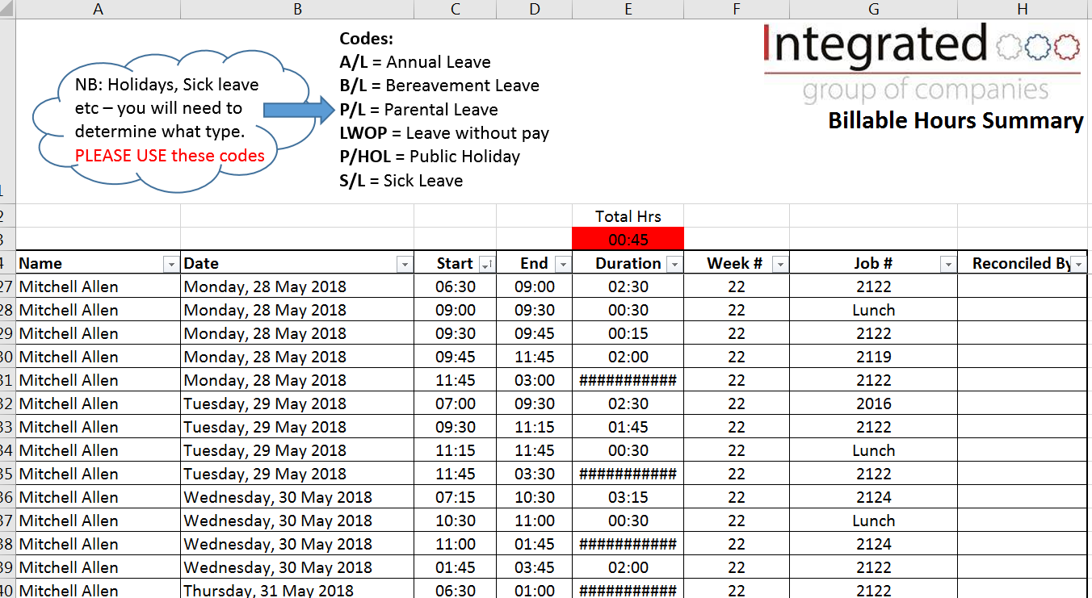
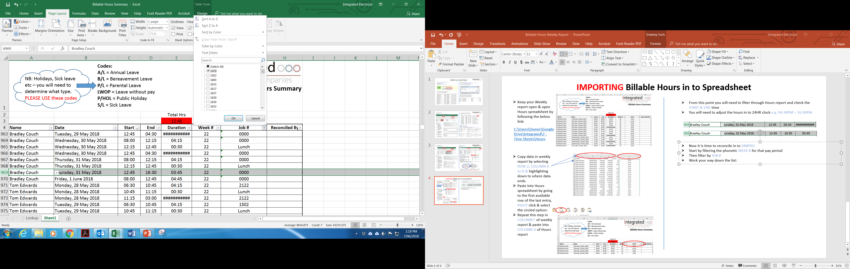
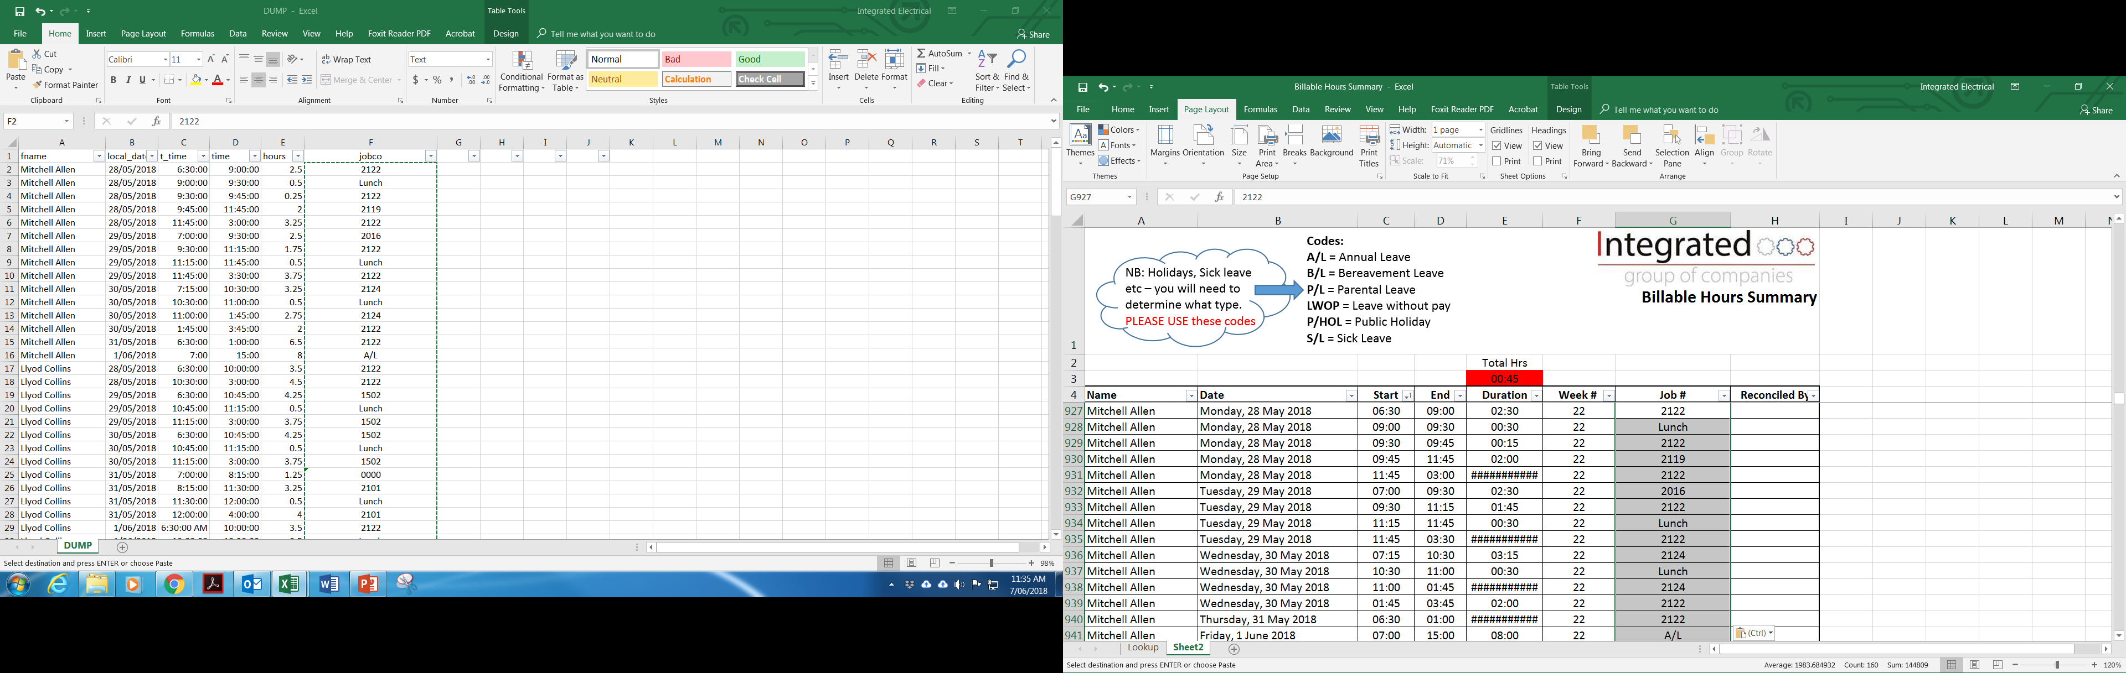
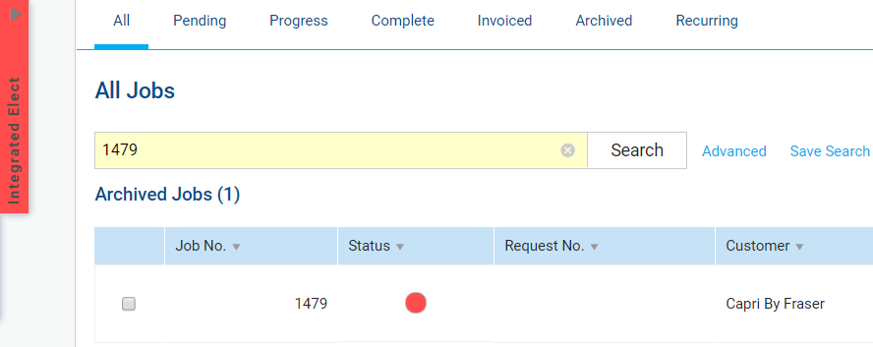
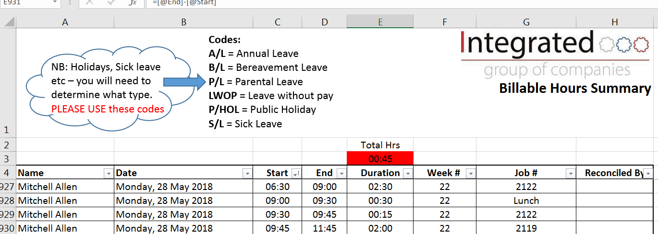
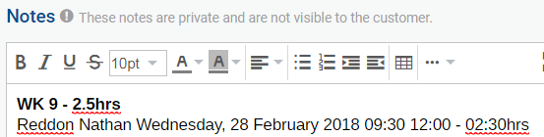
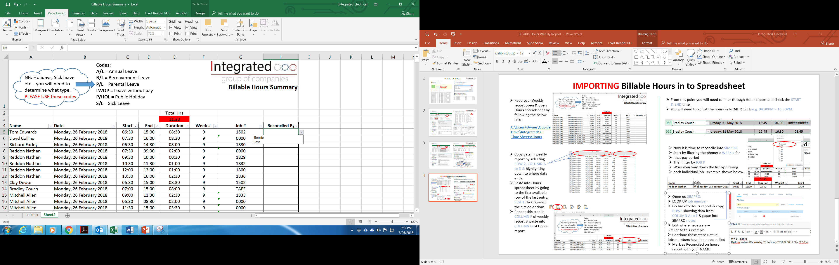
IMPORTING Billable Hours in to Spreadsheet
From this point you will need to filter through Hours report and check the START & END time
You will need to adjust the hours in to 24HR clock e.g. 04:30PM = 16:30PM.
Keep your Weekly report open & open Hours spreadsheet by following the below link:
C:\Users\Owner\Google Drive\Integrated\7 - Time Sheets\Hours
Now it is time to reconcile into SIMPRO
Start by filtering the phonetic WEEK # for
that pay period in your hours report.
Then filter by JOB #
Copy data in weekly report by selecting ROW 2, COLUMN A to D & highlighting down to where data ends.
Paste into Hours spreadsheet by going to the first available row of the last entry, RIGHT click & select the circled option:
Repeat this step in COLUMN F of weekly report & paste into COLUMN G of Hours report
Open up SIMPRO.
LOOK UP job number
Go back to Hours report & copy ROWS showing data from COLUMN A to E & paste into SIMPRO notes.
Edit where necessary –
Similar to this example
Continue these steps until all
jobs numbers have been reconciled
Mark as Reconciled by on hours report with your NAME
This is NOW complete ☺

